Slide 1
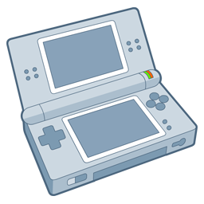

Demonstration video
Donkey Kong Jr
Homebrew App for Nintendo DS
In This Video the game is run in the Emulator
Download and installation instructions at the end of the video
dummy

